Slide 1
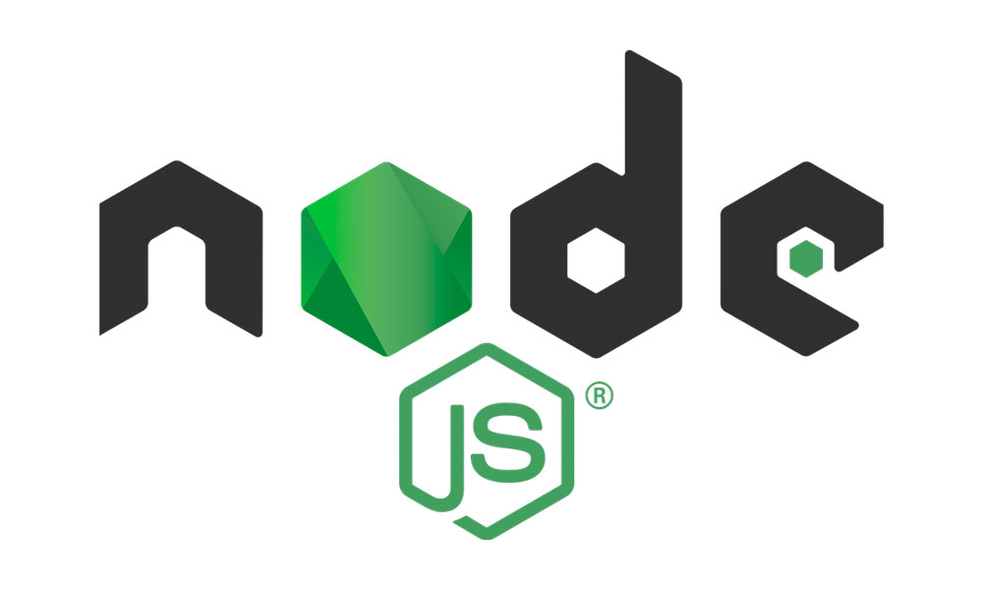
Why and When to use Node JS

